Slide 1
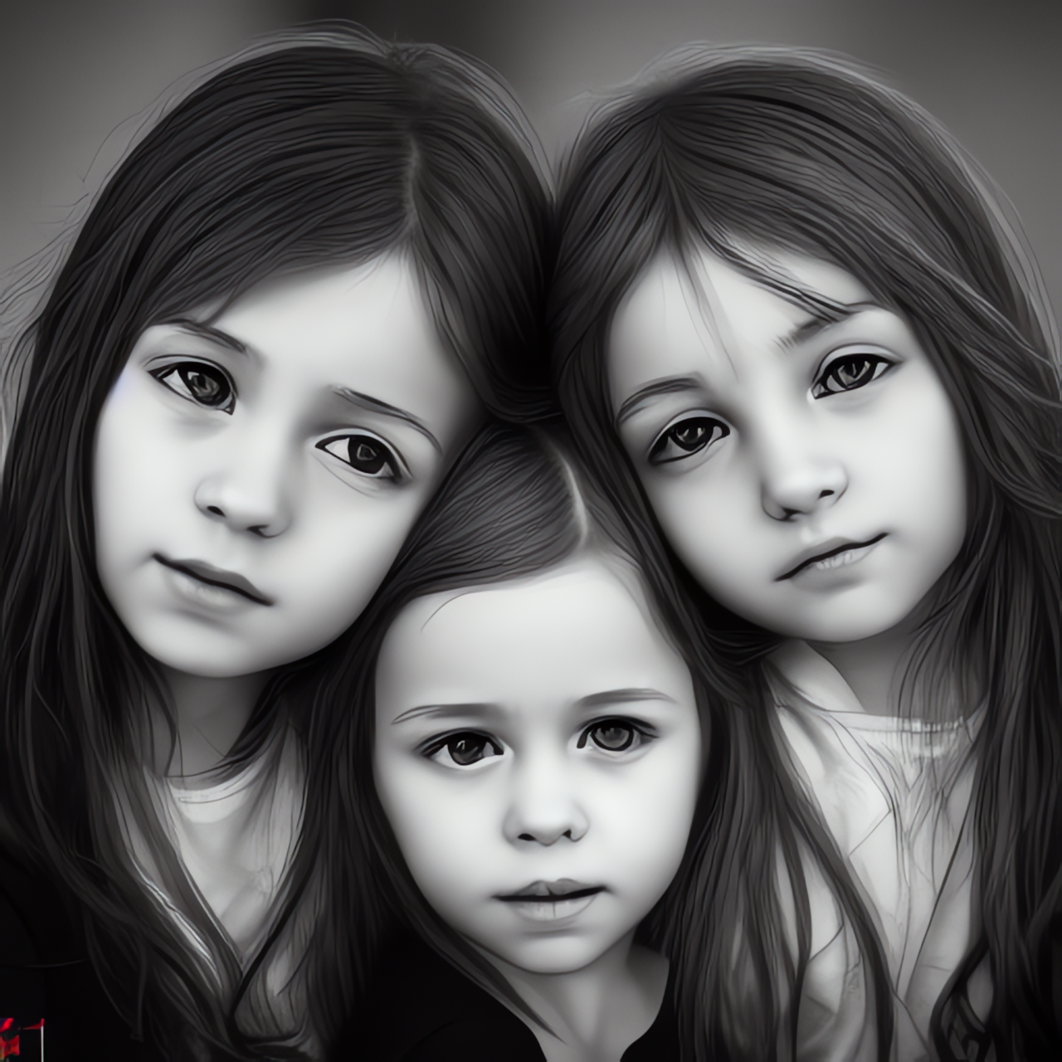
Calculating the Probability
of life events
using simple
Statistical Models

Slide 2

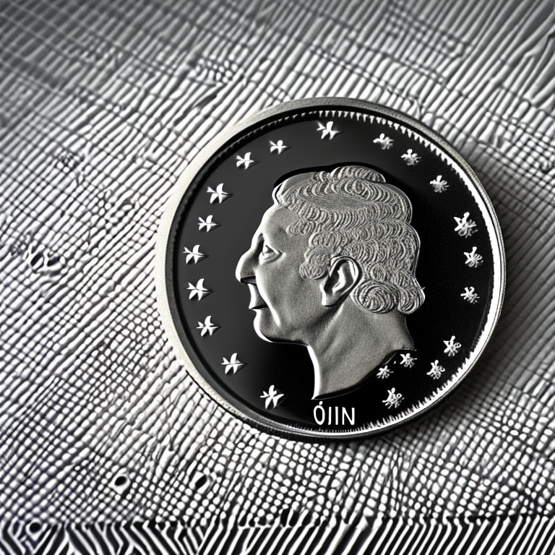
X
1 / 6 (16.7%) x 1 / 2 (50.0%) = 1 / 12 (8.3%)
Probability of rolling a 4 Probability of flipping heads

Slide 3
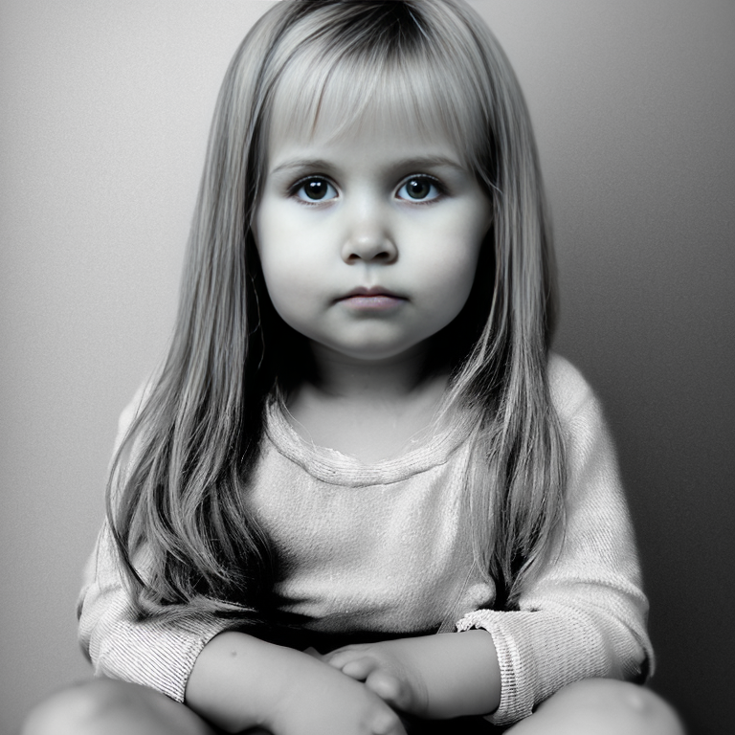
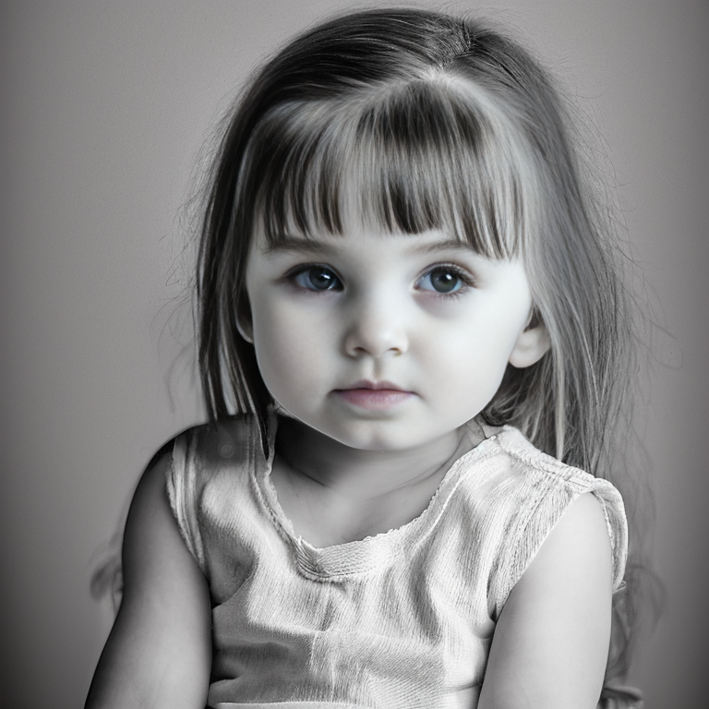

X
X
1/2 (50.0%) x 1/2 (50.0%) x 1/2 (50.0%) = 1/8 (12.5%)
Probability of “daughter” Probability of “daughter” Probability of “daughter”

Slide 4
Probability of NO marriage divorce (USA, 10 years) - 68%
Probability of NO infertility in a couple - 85%
Probability of NO long-term job displacement - 94%
Probability of NO cataclysmic aterocomet impact (10 years) - 99.97%
Probability of NO World War 3 (10 years) - 95.1%
X
X
X
1/2 (50.0%) x 1/2 (50.0%) x 1/2 (50.0%) x 51.6% = 6.5%
Probability of “daughter” Probability of “daughter” Probability of “daughter” Probabilities of “selected independent events”

Slide 5
X
X
X
Probability of family with 3 or more children (*) 12.6%
X
Probability of family with both parents present (*)
72.9%
1/2 (50.0%) x 1/2 (50.0%) x 1/2 (50.0%) x 12.6% x 72.9% = 1.1%
Probability of “daughter” Probability of “daughter” Probability of “daughter” Probabilities of “selected US census data”
(*) Probability source data from United States Census Bureau - https://www.census.gov/

